Slide 1
Douban Movie Recommendation
Jiancong Gao, Linyang He

Slide 2

Data
.sql file $→$ MySQL $→$ Python

Slide 3
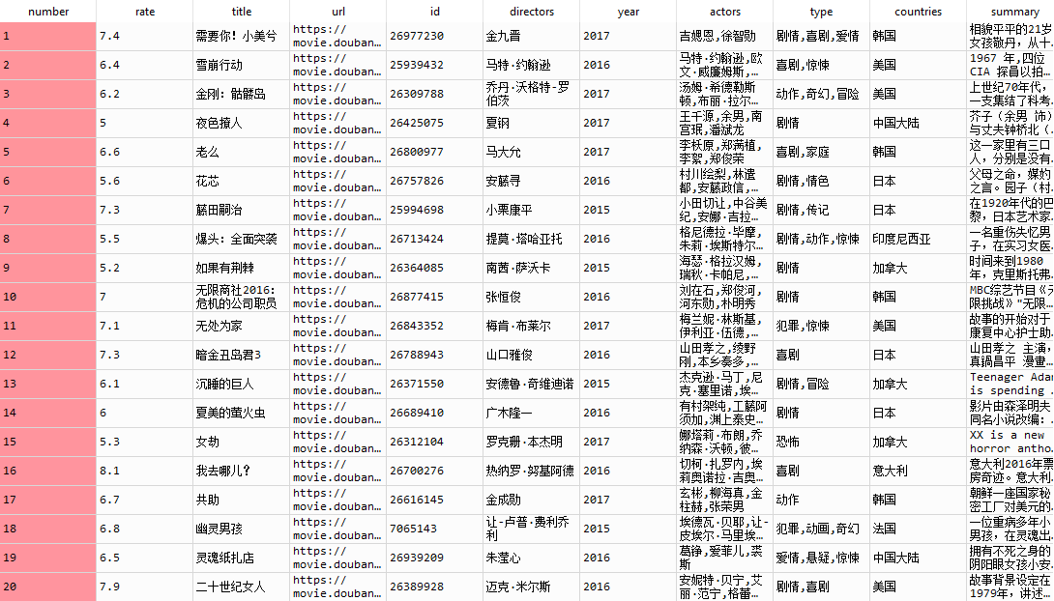
Data

Slide 4
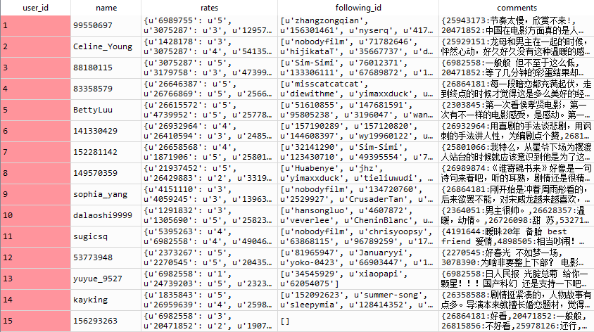
Data

Slide 5
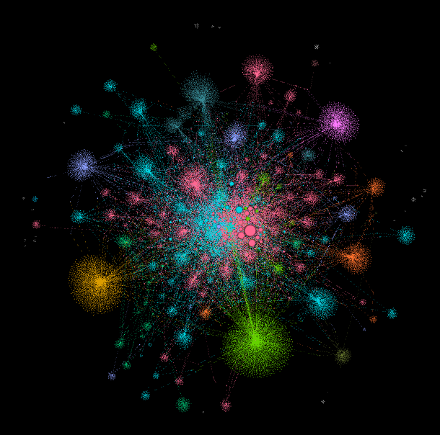
Visualization
12678 Nodes
16144 Edges

Slide 6
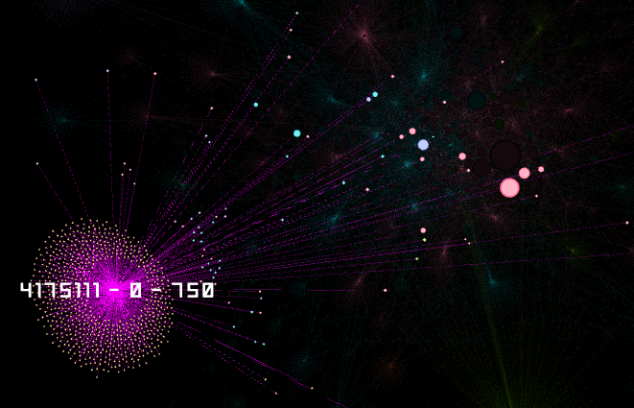
Visualization - Layout
Barnes-Hut Algorithm – Physics Model
Linear Force
Universal Gravitation
Consider those nodes who are
close to each other as a unity
Center and Edge

Slide 7
Visualization - Node Size
In degree

Slide 8
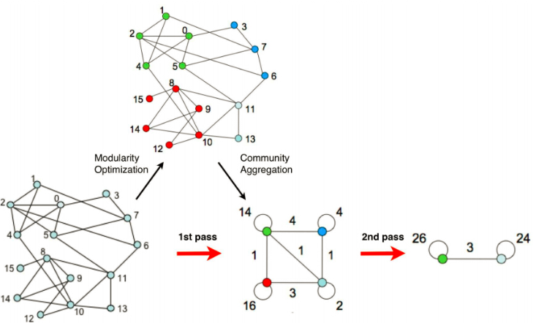

Visualization - Color
Community Division
Fast Unfolding Algorithm
Modularity
$Q=Σ_{c} [\frac{Σ_{in}}{2m}−{\left(\frac{Σ_{tot}}{2m}\right)}^{2}]$
Implement
Initialization
Modularity Optimization
Community Aggregation
Repeat
Notes:
连接较为紧密的部分可以被看成一个社区，其内部的节点之间有较为紧密的连接
社区划分的目标是使得划分后的社,区内部的连接较为紧密, 而在社区之间的连接较为稀疏
算法实现：
2. 对每个节点，将每个点尝试划分到与其邻接的点所在的社区中，计算此时的模块度，
判断划分前后的模块度是否增大，yes，则接受本次的划分，no then quit
3. 第一步划分出来的社区聚合成为一个点

Slide 9
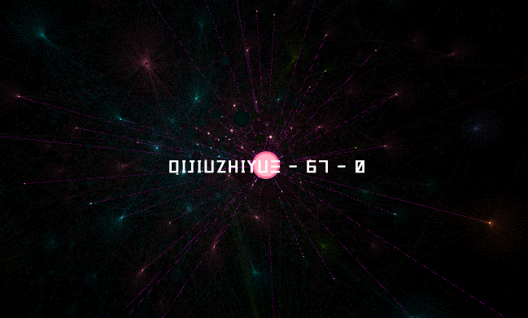
Visualization - Label
User ID – Followed Users – Following Users

Slide 10
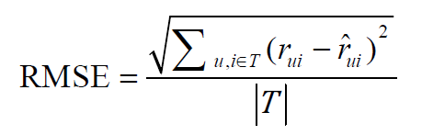
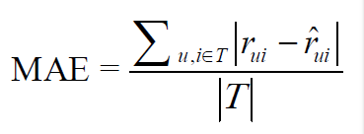
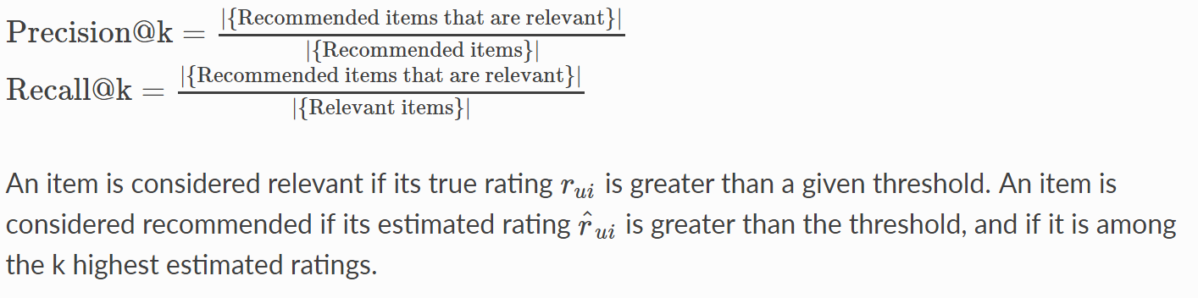

Slide 11


Baseline model
$b_{ui}=μ+b_{u}+b_{i}$
Minimize $\sum_{(u,i)}{{\left(r_{ui}−μ−b_{u}−b_{i}\right)}^{2}+λ[{\sum_{u}{b}}_{u}^{2}+\sum_{i}{b_{i}^{2}}] }$

Slide 12
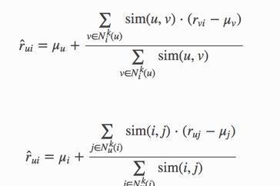
KNNBasic

Slide 13
KNNwithMeans

Slide 14
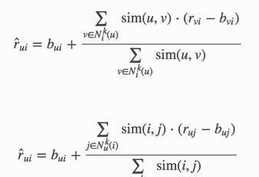
KNNBaseline

Slide 15


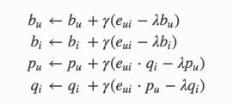
SVD

Slide 16
Results
 | BaselineOnly | KNNBasic | KNNwithMeans | KNNBaseline | SVD
precision | 0.9346 | 0.8592 | 0.8701 | 0.8749 | 0.9119
recall | 0.1344 | 0.1519 | 0.1697 | 0.1613 | 0.1536
MAE | 0.6849 | 0.7092 | 0.6837 | 0.6641 | 0.6770
RMSE | 0.8635 | 0.9108 | 0.8750 | 0.8513 | 0.8595

Slide 17
Top-N

Slide 18
Future Work

Slide 19
Content-based
Directors
Actors
Type
Countries
Summary: TF-IDF

Slide 20
User Information
Social Factors:
Following Users & Follower
Comments:
Semantic Analysis
Keyword (Actors, Directors, Type, …)

